Slide 1
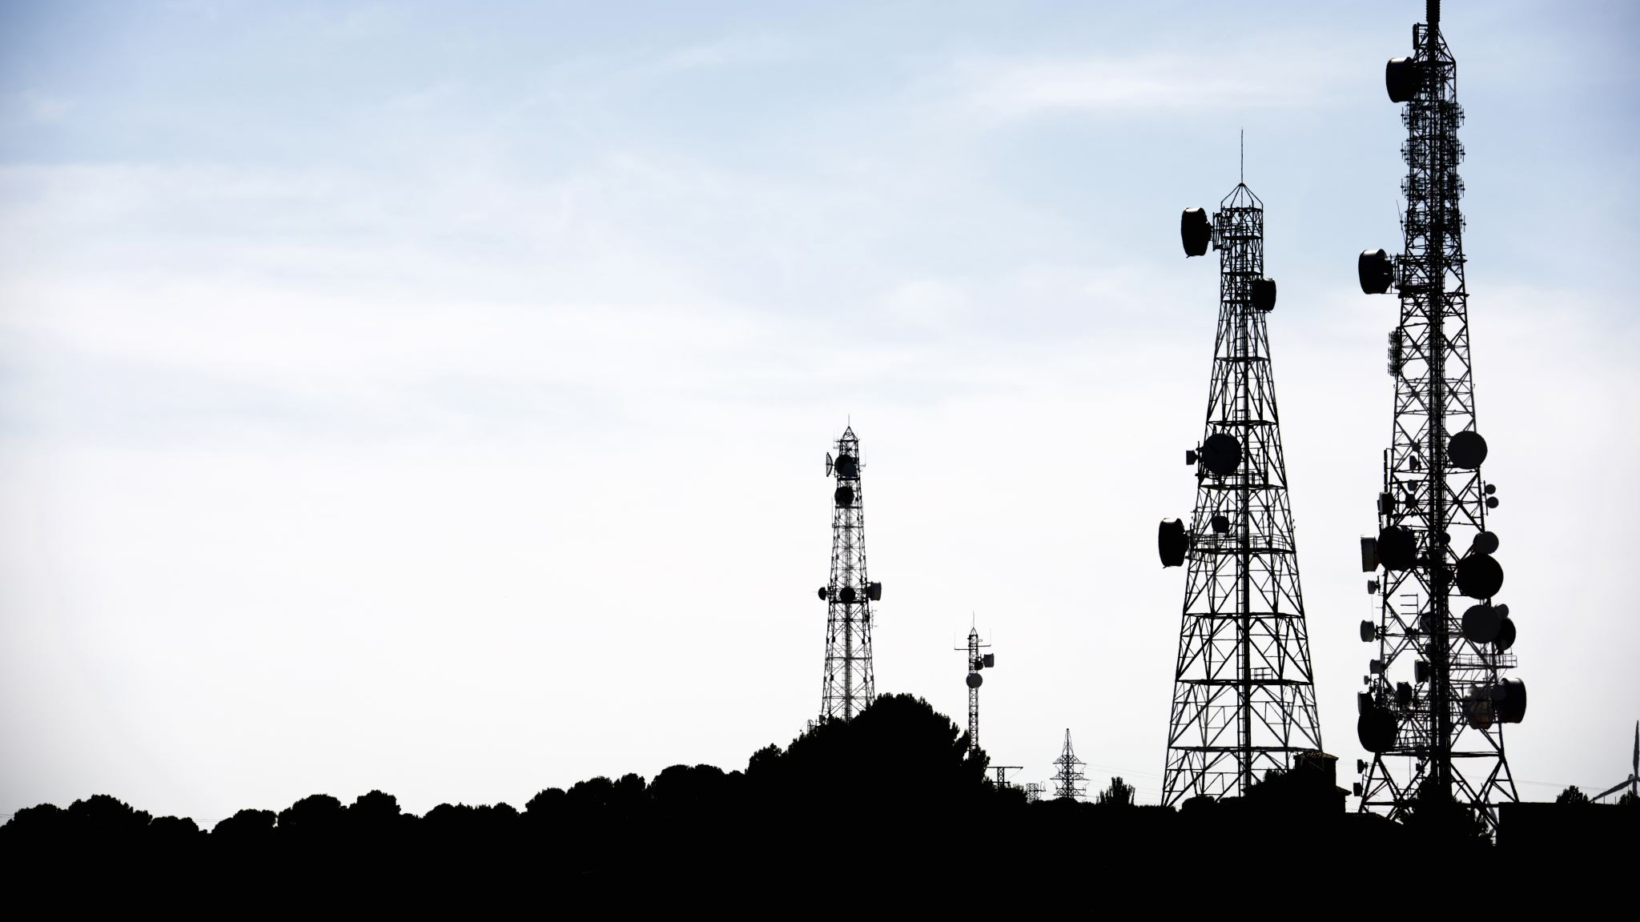

Telecom Churn Prediction

Slide 2

Introduction
Churn?
The rate at which customers stop doing business with an entity which in our case is the telecom industry.
There are numerous causes that can create churn. Focusing on these aspects can lower the percentage of consumers leaving.

Slide 3
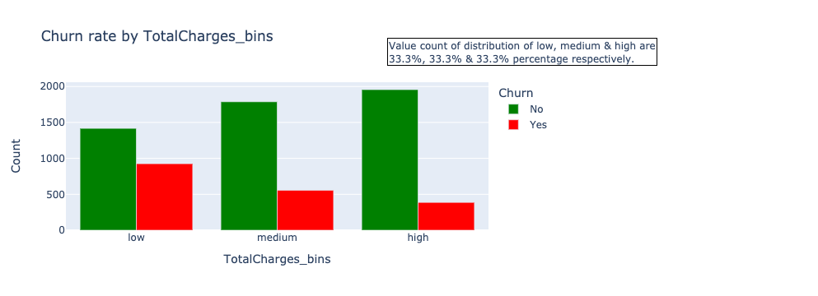
Dataset
Telco Customer Churn
WA_Fn-UseC_-Telco-Customer-Churn.csv
This dataset helps us in predicting the behavior which in turn can be used to retain customers. We can analyze all relevant customer data and develop focused customer retention programs.
Each row represents a customer, each column contains customer’s attributes like total charges that describes the customers information.

Slide 4
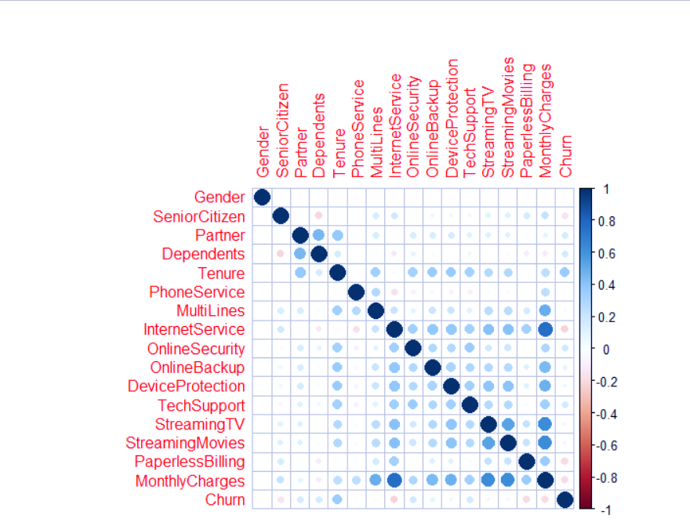
Correlation
Correlation is a statistical measure that expresses the degree to which two variables are linearly connected.
In this experiment, we are examining the relationships between a variety of factors, including tenure, overall costs, and telecom churn.
This correlation test identifies the variables that contribute the most to determining churn.

Slide 5
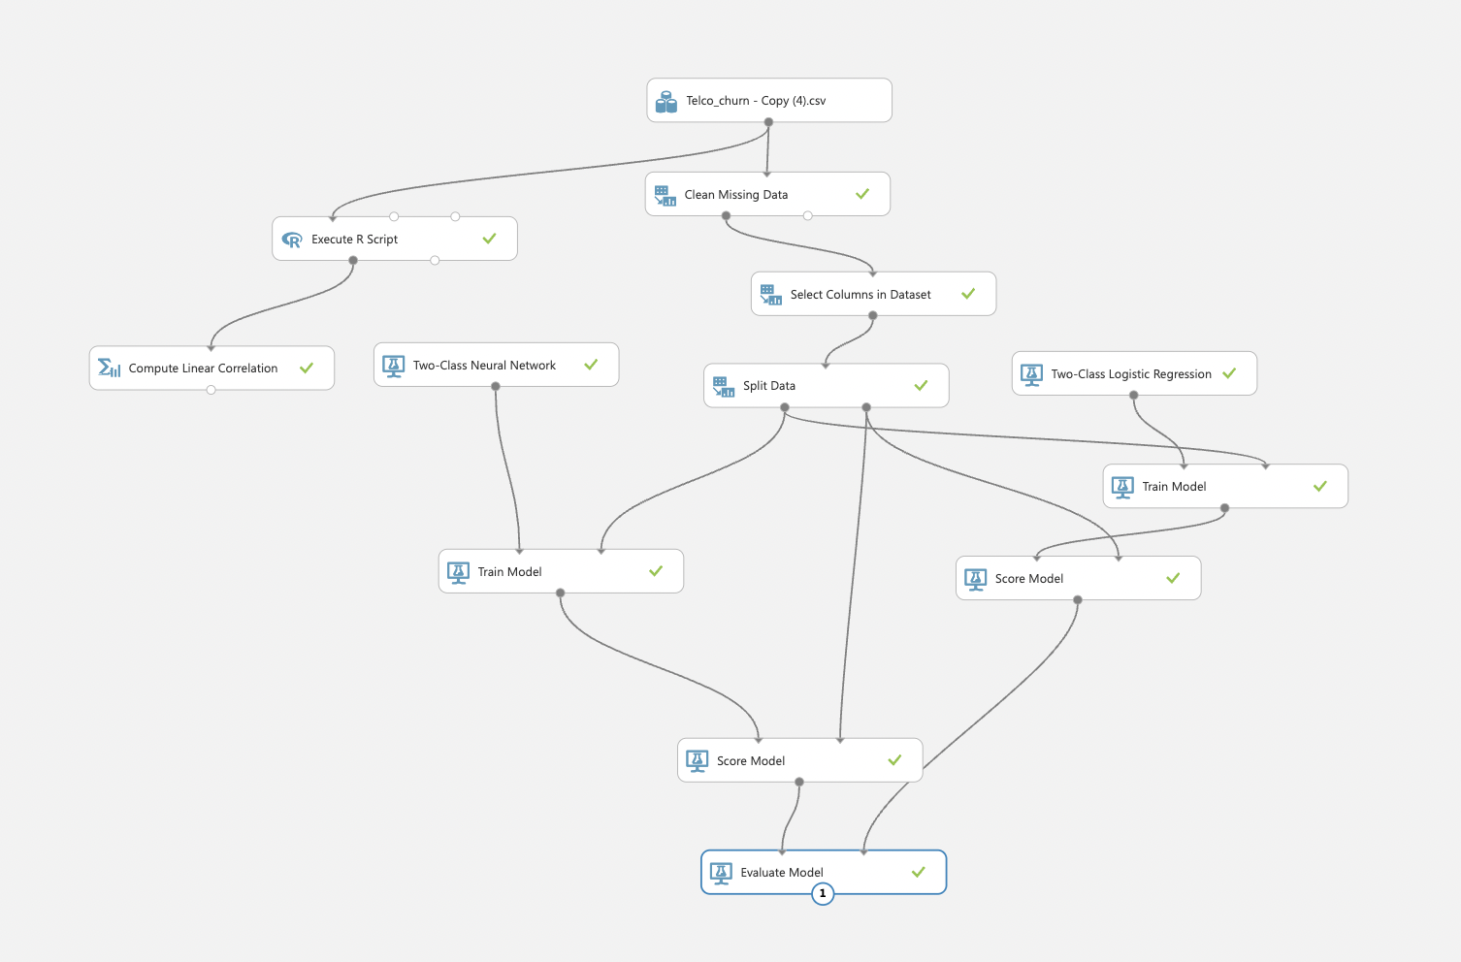
Building Models using Azure ML
Azure ML software has been used to build the model, which included two-class logistic regression, two-class neural network models.

Slide 6
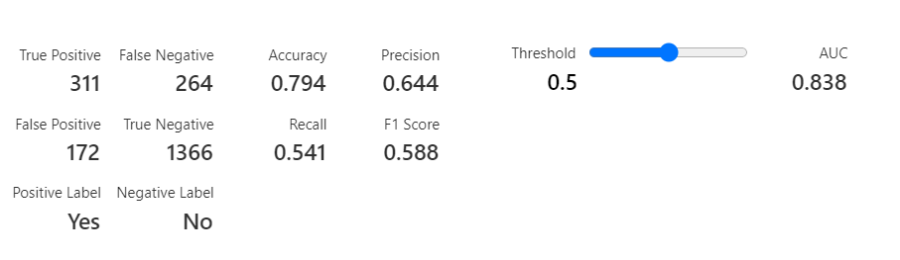
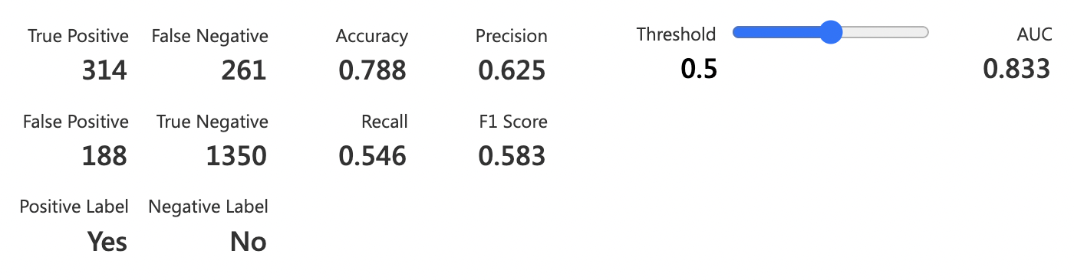
Evaluation Metrics
For Classification Models:
We have used the two-class Logistic regression and the two-class neural network in our model to classify the data.
Accuracy
Precision
Recall
F1 Score
AUC (Area Under the Curve)

Slide 7
Conclusion
Every quarter, we extract the churn statistics based on the findings mentioned above. We track down the individuals who might want to stop working with the operator and send email surveys to learn more about their issues.
Based on the survey results, we categorize the customer complaints into distinct groups, assign teams to each group to address the complaints, and implement steps to prevent future recurrences.

Slide 8
References:
https://www.kaggle.com/datasets/blastchar/telco-customer-churn

Slide 9
Thank you! Presented by: Akshay Ramesh Dhanunjan Reddy Raghuram J.V.N. Sai Kumar Maturi Ranjith Kumar Kanumilli Sampreeth Maturi

